Slide 1
Eat with Chef system
Group 6

Slide 2
Contents
Problem
Solution
Main Functions
Technology
Summary
Demo

Slide 3

Problem
Does not have enough time to prepare
Does not have experience to design
Want to daily flexible menu
Want to eat a good foods with family but…
Worry about food safety
Customer

Slide 4




Problem
Increase sale
Business owner want…
Customer relation ship

Slide 5
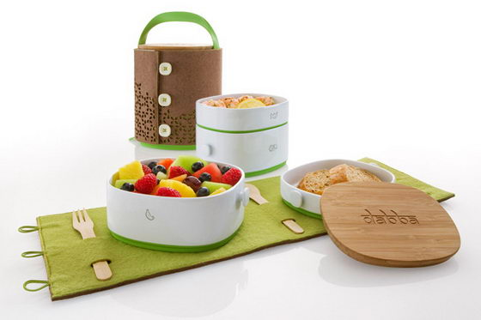


Problem
Design a good meal for customer
Chef want…
Share their cooking experience

Slide 6
Solution
Eat with chef

Slide 7

Solution
Business owner
Eat with chef
System
Customer
Chef

Slide 8
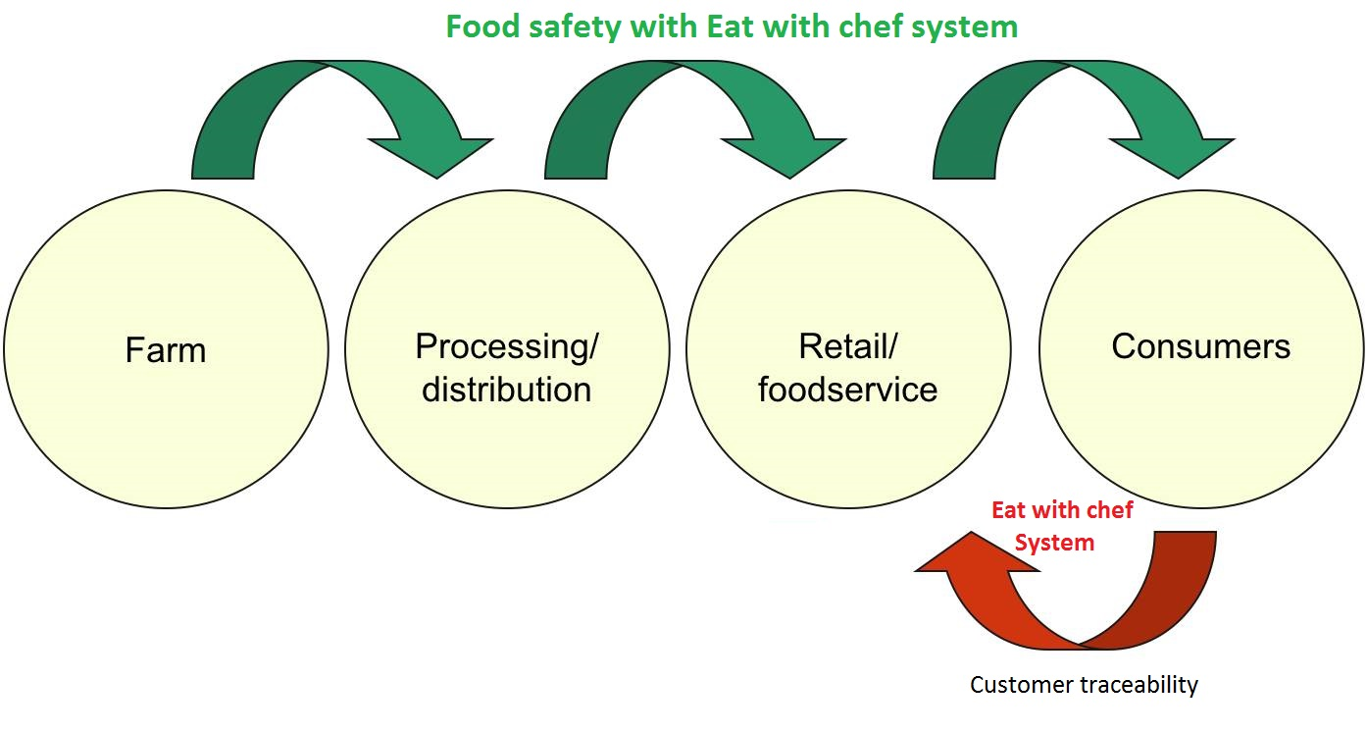
Solution

Slide 9
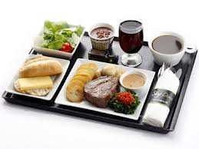

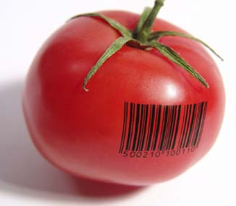
Main functions
Order dishes
Online payment
Customer
View ingredient traceability

Slide 10

Chef
Create dish produce session
Chef

Slide 11
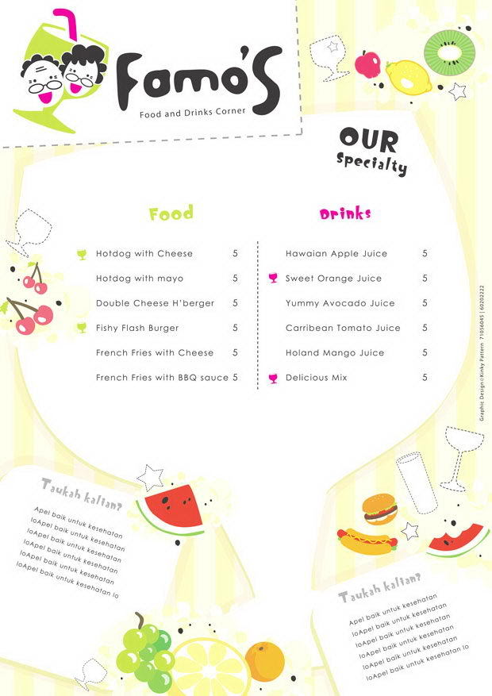

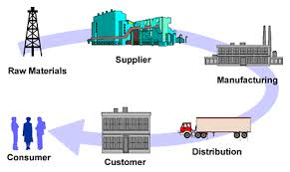
Staff
Publish daily menu
Manage supplier & Ingredient
Staff

Slide 12
Food Safety
EWC Food Safety
Food Origin
How to prepare to cook safety
When is the food cooked

Slide 13
Food Traceability
An effective traceability system relies on being able to track product one step forward and one step back at any point in the supply chain.

Slide 14
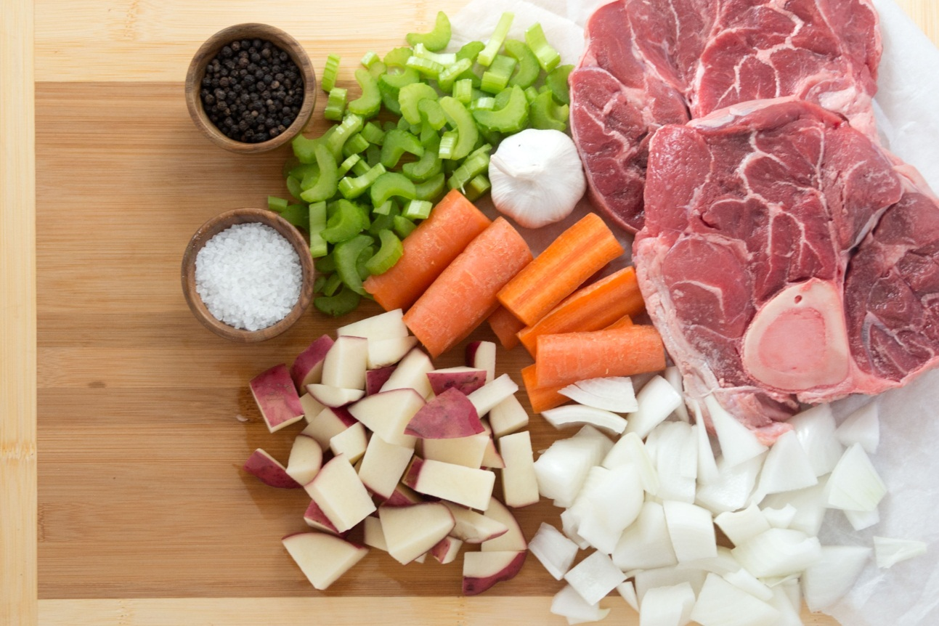
Food Traceability
Traceability should be able to identify the source of all food input:
raw materials
additives
other ingredients
packaging
Main Ingredients

Slide 15
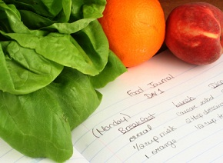
Food Traceability
The system has in place includes any procedures for identifying producers, suppliers, customers and products and the records:
name and address (and other contact details) of suppliers/customers
date of transaction or delivery
batch or lot identification
volume or quantity of product
any other relevant production records

Slide 16
Food Traceability Process - Step 1
Staff
Publish daily menu

Slide 17
Food Traceability Process - Step 2
Order dishes
Customer

Slide 18
Food Traceability Process - Step 3
Chef
Create dish produce session

Slide 19


Food Traceability Process - Step 4
Scan QR Code
Customer
Food Origin

Slide 20





Technology
Microsoft Team foundation server

Slide 21
Summary
Achievement
Customer can order dishes easily
Customer can view ingredient traceability by QR code and web
Customer can ask cooking question with chef
Staff can publish and manage flexible daily menu
Staff can manage orders easily
Chef can create produce session
Chef can answer cooking question
Limitation
Support only one payment method with Pay Pal
Does not support delivery system

Slide 22
Summary
Future plan
Develop delivery system.
Integrate more online payment methods
Implement gaming and more social for customer
Improve system performance
Improve system as user friendly as possible
Improve business concept

Slide 23
Q&A
Thanks for your listening

